Slide 1
Next Steps to evaluate or use Microsoft Azure …
The best ways for Software Developers / ISVs to evaluate the platform and get support …

Slide 2
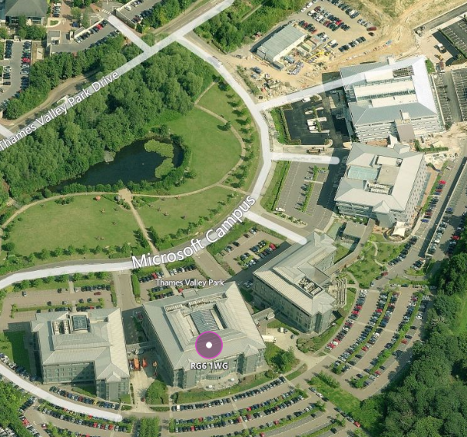
1. Connect with Microsoft UK …
The Microsoft Developer Experience (DX) team has a Partner Business Evangelist (PBE) team who work with Software Developers / ISVs of all sizes.
PBE’s are:
Commercial in focus (some are also technical).
Ideally suited to help you navigate Microsoft.
Your best route to the Technical Evangelist team.
Measured on the total Azure consumption of their partners.
Aligned by industries (Fin. Services, Retail, Media, Public Sector, Education, etc.).
Notes:
Connect with Microsoft UK.
But how? There are almost 4000 staff in the UK, mostly in 5 Buildings in the Reading HQ.
A Partner Business Evangelist is there to help you.
PBE’s are (explain):
Commercial in focus (some are also technical).
Ideally suited to help you navigate Microsoft.
Your best route to the Technical Evangelist team.
Measured on the total Azure consumption of their partners.
Aligned by industries (Fin. Services, Retail, Media, Public Sector, Education, etc.).

Slide 3
2. Use free/low-cost Azure licences for a pilot. Ways to get them include …
# | Program Name, URL | Audience | Cost | Duration | Free Azure Level | Requirements
1 | Azure Free Trial - https://azure.microsoft.com/en-gb/pricing/free-trial/ | Anyone | None | 30 days | GBP 125 | Credit Card for Validation (not charged unless you upgrade.)
2 | BizSpark - https://www.microsoft.com/bizspark/default.aspx | Start-ups | Free | 3 years | $150 x 5 developers = $750. Plus more. | Registered Co. < 5 years old. < $1M turnover. Have own web site.
3 | MSDN (MSFT Dev Network) or Visual Studio subscription - https://mspartner.microsoft.com/en/uk/pages/membership/msdn-subscriptions.aspx and https://www.visualstudio.com/products/subscriber-benefits-vs#SKUDetailList_1 | Dev teams | $45 /month /person Or $539/year /person | As long as subscribed | $150 /month /person | Enroll as MS Registered Partner (no cost); then purchase subscription. Credit card validation required.
4 | MPN Action Pack (for application builders) - https://mspartner.microsoft.com/en/uk/pages/membership/action-pack-application-design-development.aspx | Partners | $475/year | 12 months | $100 /month | Enroll as MS Registered Partner (no cost). Then purchase Action Pack. Ideal if one wants to earn Silver or Gold status in medium term.
5 | Azure (Customer) Pass - https://azure.microsoft.com/en-gb/offers/azure-pass/ | Partners | None | 3 months | $500 /month | Apply via MSFT account manager for chosen managed customer. Redeem online (if granted).
Notes:
Explain each option.
Be clear about BizSpark entitlement (must be less than 5 years old and turn over <$1000 (not GBP).

Slide 4
3. Use the available support channels …
The fastest way to get a response to your technical or account issues, is through raising a ticket via the Azure portal. Account and Billing support tickets are provided free of charge, and Technical support is available via one of the support packages listed below. See:
http://www.windowsazure.com/en-us/support/plans/
Support FAQ’s
Name | Price | Response Time | Detail
Core | Included at no extra cost | NA | Forum support Account/Billing management
Developer | $29 a month | <8 Hours | Unlimited break/fix via Web Submission NB. Not available for Azure EA
Standard | $300 a month | <2 Hours | Unlimited break/fix via Web Submission 3 x Telephone call backs per month
Pro-Direct | $1000 a month | <1 Hour | Unlimited Telephone call backs with Priority handling Escalation services Pooled A/C management Some Proactive services
Premier | >$3000 a month | <1 Hour Minimum | Unlimited Priority Telephone Assigned ADM Bespoke Proactive services/mentoring Rapid Response option
For Escalations:
Subscription Management: wasmsesc@microsoft.com
Technical Support: APTSI@microsoft.com
Professional Direct Escalation: PDAzure@microsoft.com
If you need someone to pick up the case if the Case owner is Out of the office/Away: aznext@microsoft.com.

Slide 5
Next Steps to evaluate or use Microsoft Azure …
Connect with your Partner Business Evangelist and get started !

